Slide 1
Python
SlideMake.com

Slide 2
Introduction to Python
Python is a high-level programming language known for its simplicity and readability.
It supports multiple programming paradigms, including procedural, object-oriented, and functional programming.
Python is widely used in various domains such as web development, data science, artificial intelligence, and automation.
Notes:
Image source: https://kochiva.com/blog/python-programming-language/

Slide 3
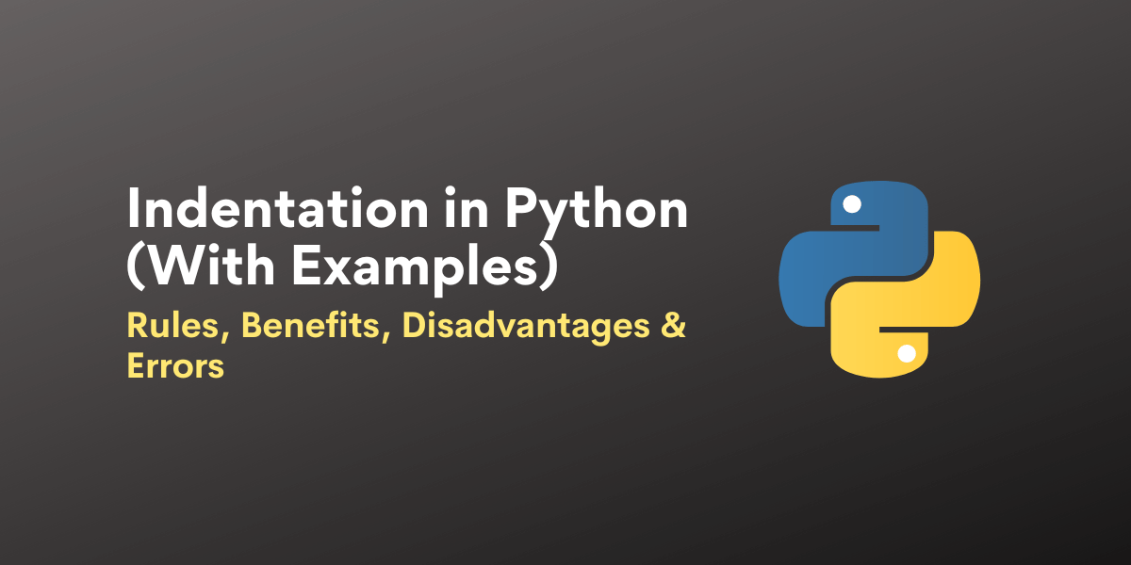
Python Syntax
Python uses indentation to define code blocks rather than curly braces, making it easier to read and understand.
It has a simple and concise syntax that allows developers to write code quickly and efficiently.
Python uses dynamic typing, where variables do not need to be explicitly declared with a data type.
Notes:
Image source: https://www.askpython.com/python/python-indentation

Slide 4
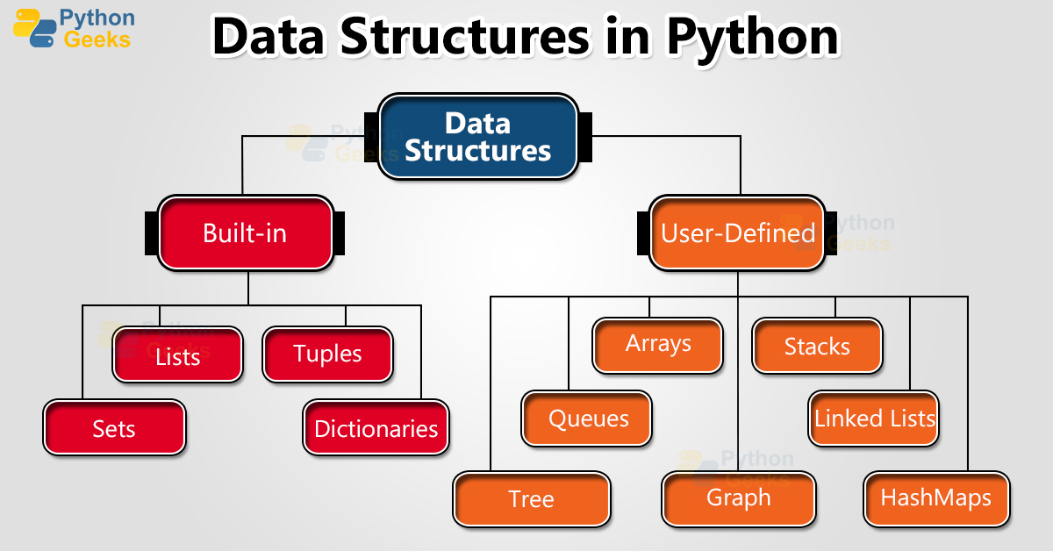
Data Structures in Python
Python provides built-in data structures like lists, dictionaries, tuples, and sets to store and manipulate data.
These data structures are versatile and can be used in various ways to solve different types of problems.
Python also supports libraries like NumPy and Pandas for working with arrays and data frames.
Notes:
Image source: https://pythongeeks.org/python-data-structures/

Slide 5
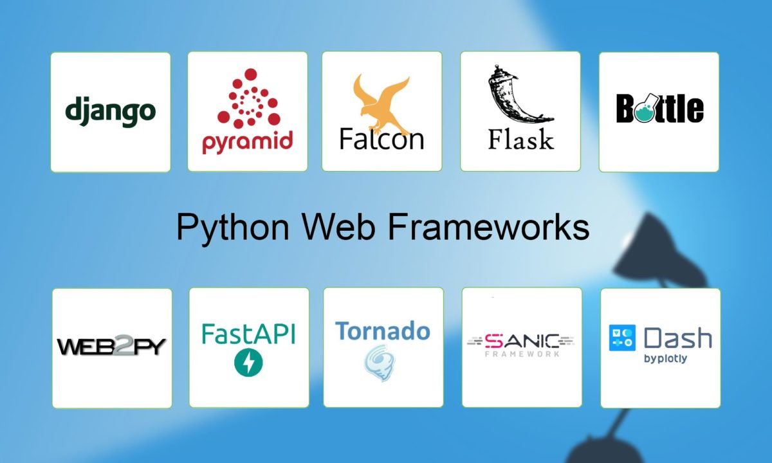
Python Libraries and Frameworks
Python has a rich ecosystem of libraries and frameworks that simplify development tasks.
Libraries like BeautifulSoup for web scraping, requests for handling HTTP requests, and Matplotlib for data visualization are widely used.
Frameworks like Django and Flask are popular for web development in Python.
Notes:
Image source: https://infolearners.com/best-simple-python-web-framework/

Slide 6
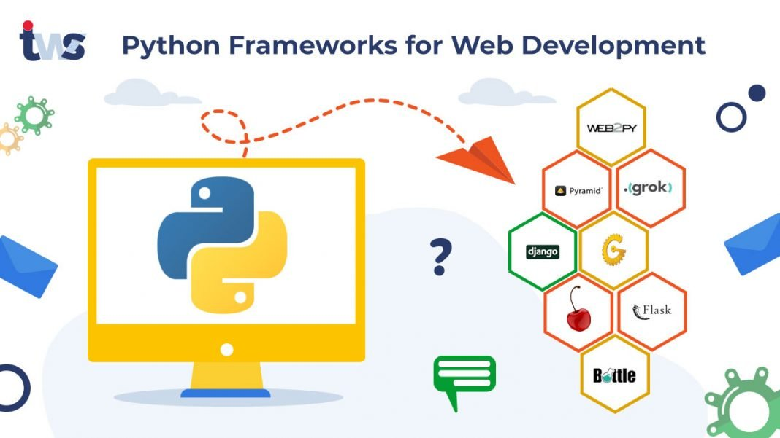
Python for Web Development
Python is commonly used for web development due to its simplicity and versatility.
Frameworks like Django provide a full-stack solution for building web applications.
Python's integration with databases like SQLite, MySQL, and PostgreSQL makes it suitable for backend development.
Notes:
Image source: https://morioh.com/p/06e806cae195

Slide 7
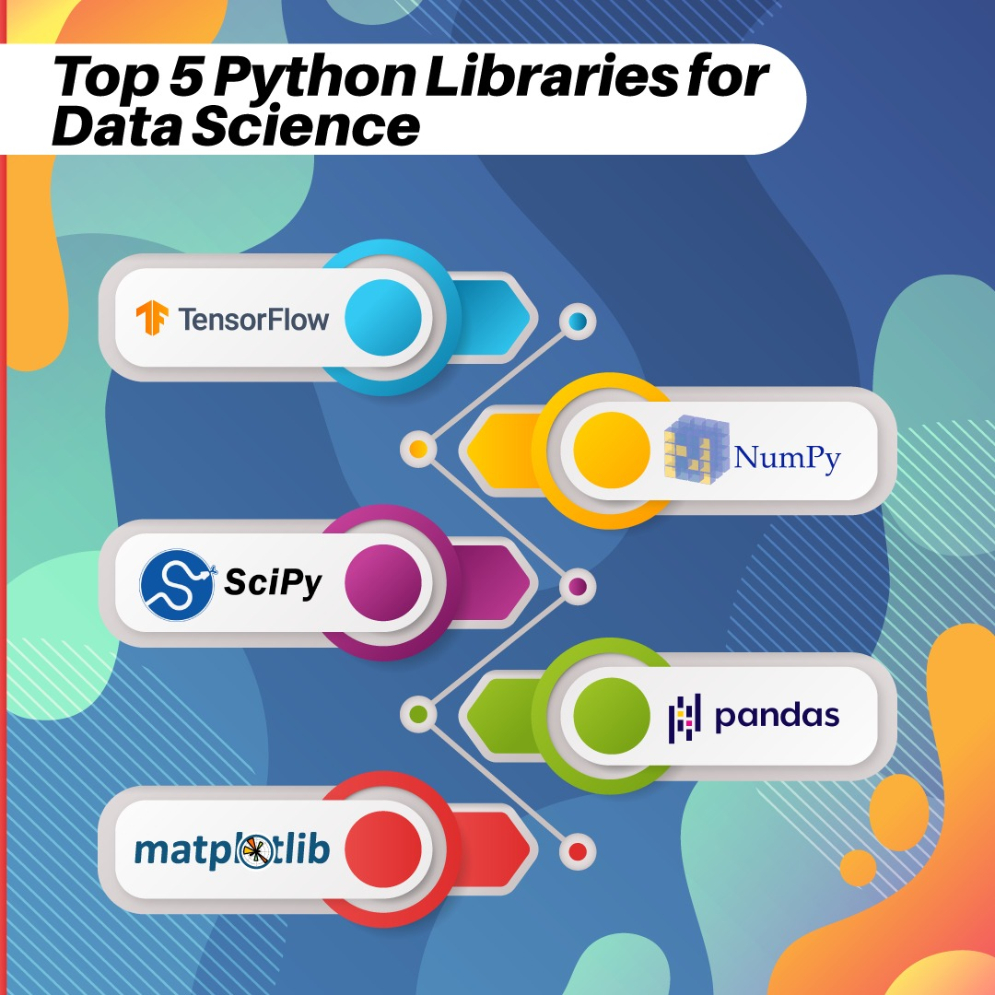
Python for Data Science
Python is a popular choice for data science and machine learning due to libraries like NumPy, Pandas, and Scikit-learn.
Jupyter Notebooks provide an interactive environment for data analysis and visualization in Python.
Python's simplicity and readability make it ideal for prototyping and experimenting with data.
Notes:
Image source: https://blog.skillmonks.com/top-5-python-libraries-for-data-science/

Slide 8
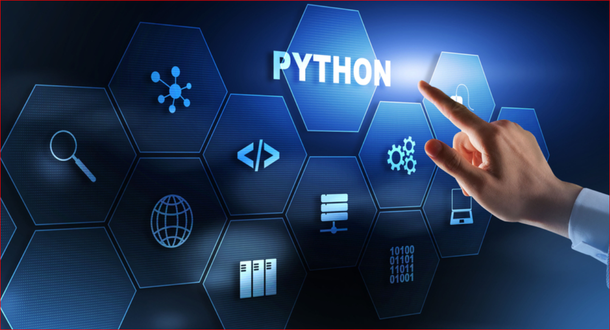
Python for Artificial Intelligence
Python is widely used in artificial intelligence and machine learning projects.
Libraries like TensorFlow and PyTorch enable developers to build and train neural networks.
Python's flexibility and extensive community support make it a preferred choice for AI development.
Notes:
Image source: https://pythontraininginpune.com/role-of-python-in-artificial-intelligence/

Slide 9
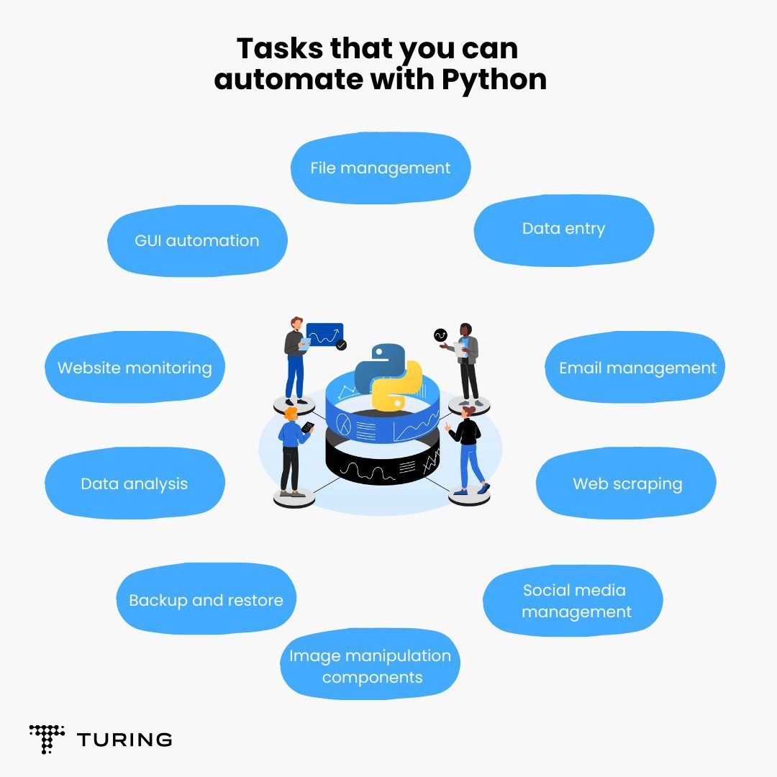
Python for Automation
Python is often used for automation tasks such as scripting, data processing, and system administration.
Tools like Selenium and PyAutoGUI allow automation of web interactions and GUI-based tasks.
Python's cross-platform compatibility makes it suitable for automating tasks on different operating systems.
Notes:
Image source: https://www.turing.com/kb/automating-tasks-with-python-scripts

Slide 10
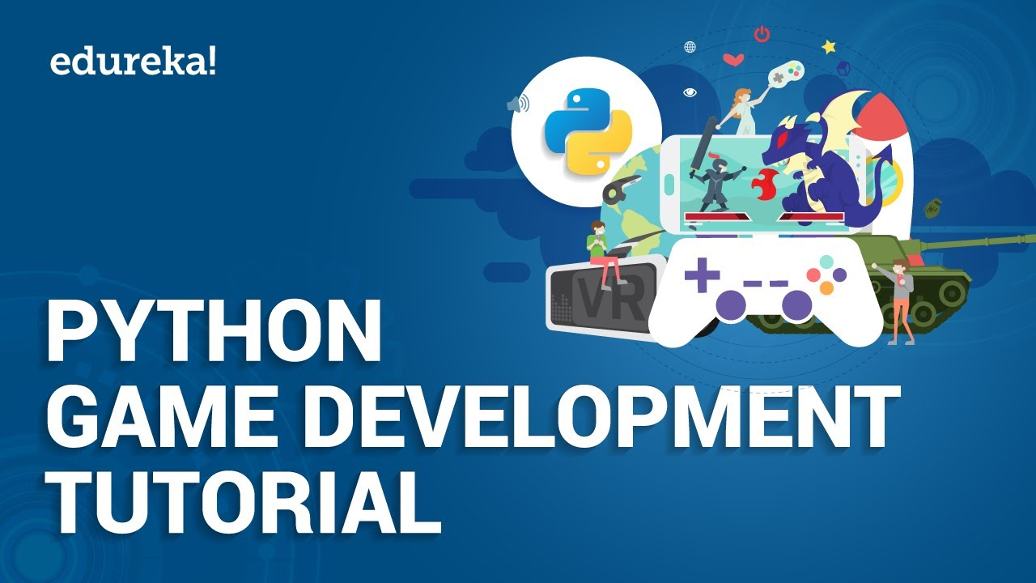
Python for Game Development
Python is used in game development for prototyping, scripting, and building game engines.
Libraries like Pygame provide a framework for creating 2D games in Python.
Python's simplicity and ease of use make it a good choice for beginners in game development.
Notes:
Image source: https://quadexcel.com/wp/python-games-development-tutorial-pygame-tutorial-for-beginners-python-training-edureka/

Slide 11
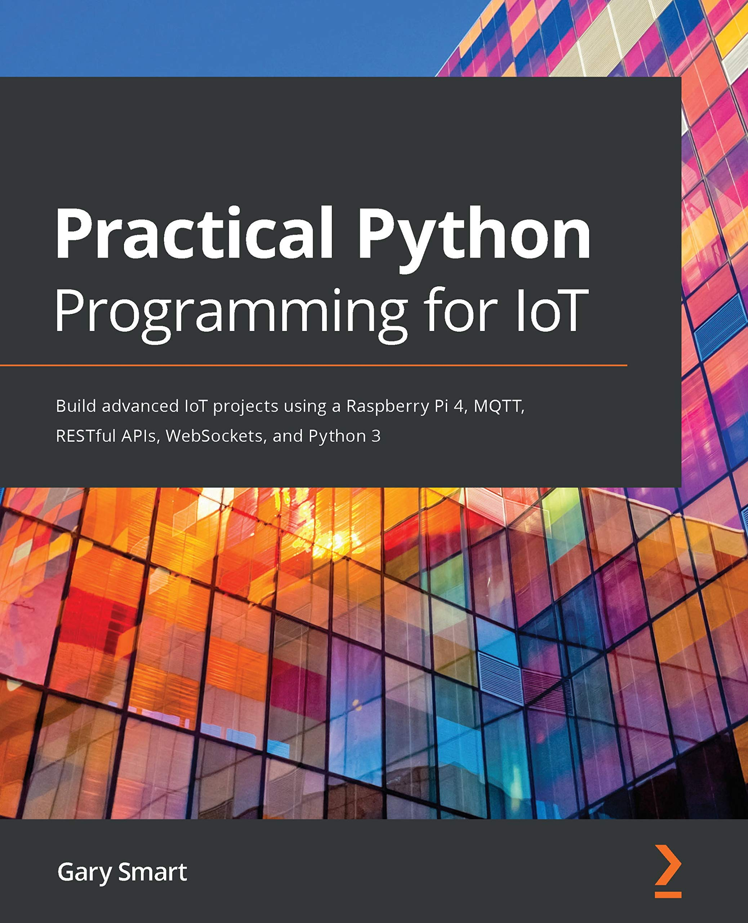
Python for Internet of Things (IoT)
Python is used in IoT projects for developing applications that interact with sensors and devices.
Libraries like GPIO Zero and MicroPython make it easy to work with hardware components using Python.
Python's versatility and rich library ecosystem support a wide range of IoT applications.
Notes:
Image source: https://www.goodreads.com/book/show/55941453-practical-python-programming-for-iot

Slide 12
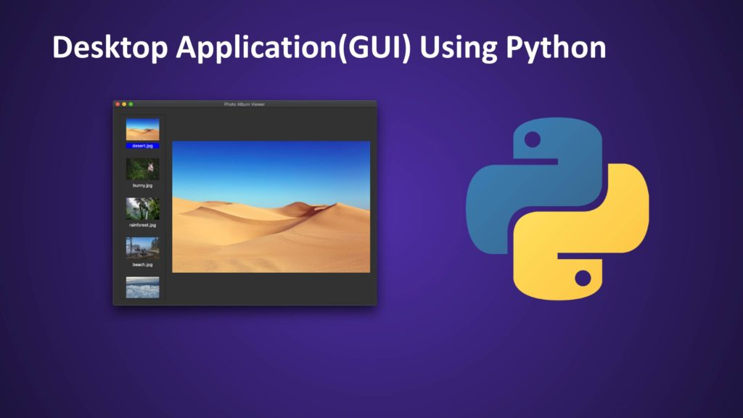
Python for Desktop Applications
Python can be used to build desktop applications using libraries like Tkinter and PyQt.
Tools like PyInstaller enable developers to package Python applications into standalone executables.
Python's simplicity and cross-platform compatibility make it suitable for developing desktop software.
Notes:
Image source: https://morioh.com/p/d4652929712a

Slide 13
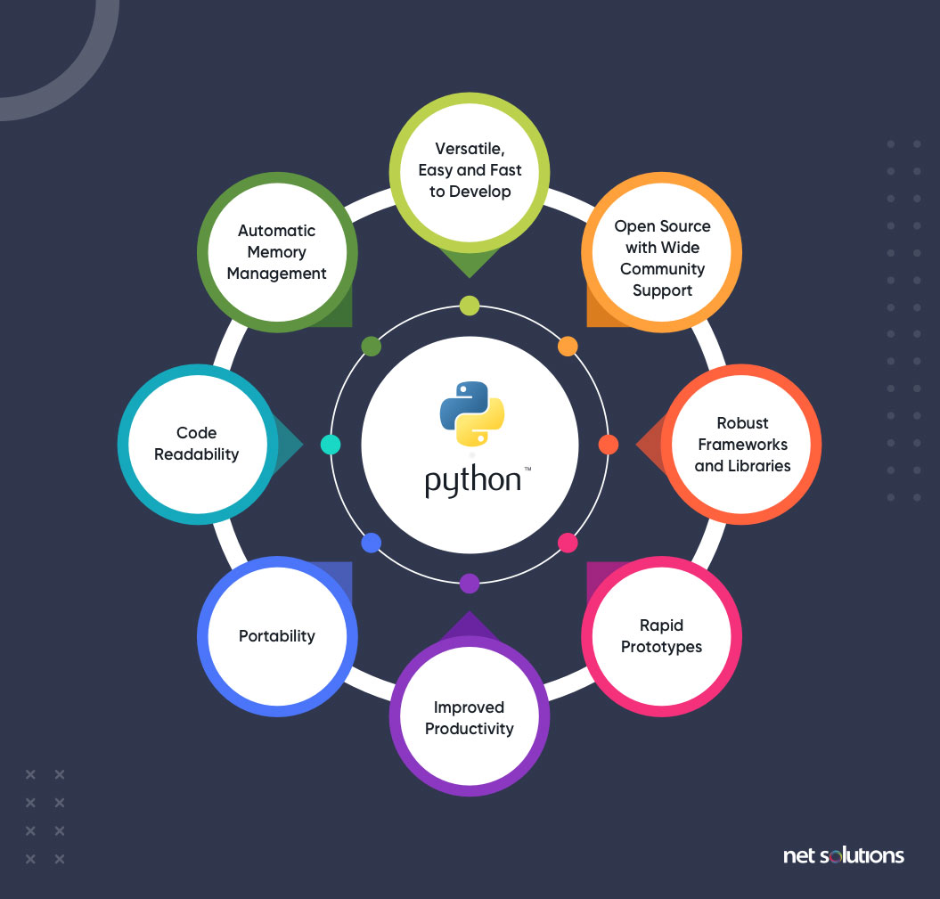
Python's Community and Support
Python has a large and active community of developers who contribute to its growth and development.
The Python Software Foundation oversees the development of Python and promotes its use worldwide.
Online forums, tutorials, and documentation are available to support Python developers at all skill levels.
Notes:
Image source: https://fipise.com/article/what-is-python-why-does-it-matter-in-software-development

Slide 14
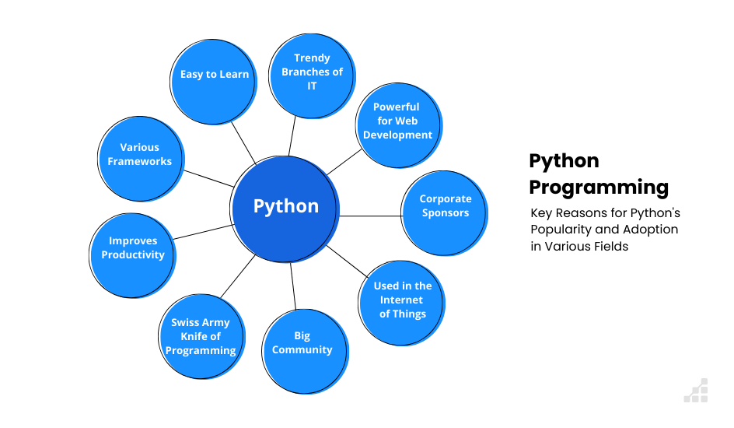
Python's Popularity and Adoption
Python has gained popularity in recent years and is ranked among the top programming languages.
Companies like Google, Facebook, and Netflix use Python for various applications and services.
Python's versatility, ease of learning, and wide applicability contribute to its increasing adoption.
Notes:
Image source: https://www.scalablepath.com/python/python-popularity

Slide 15
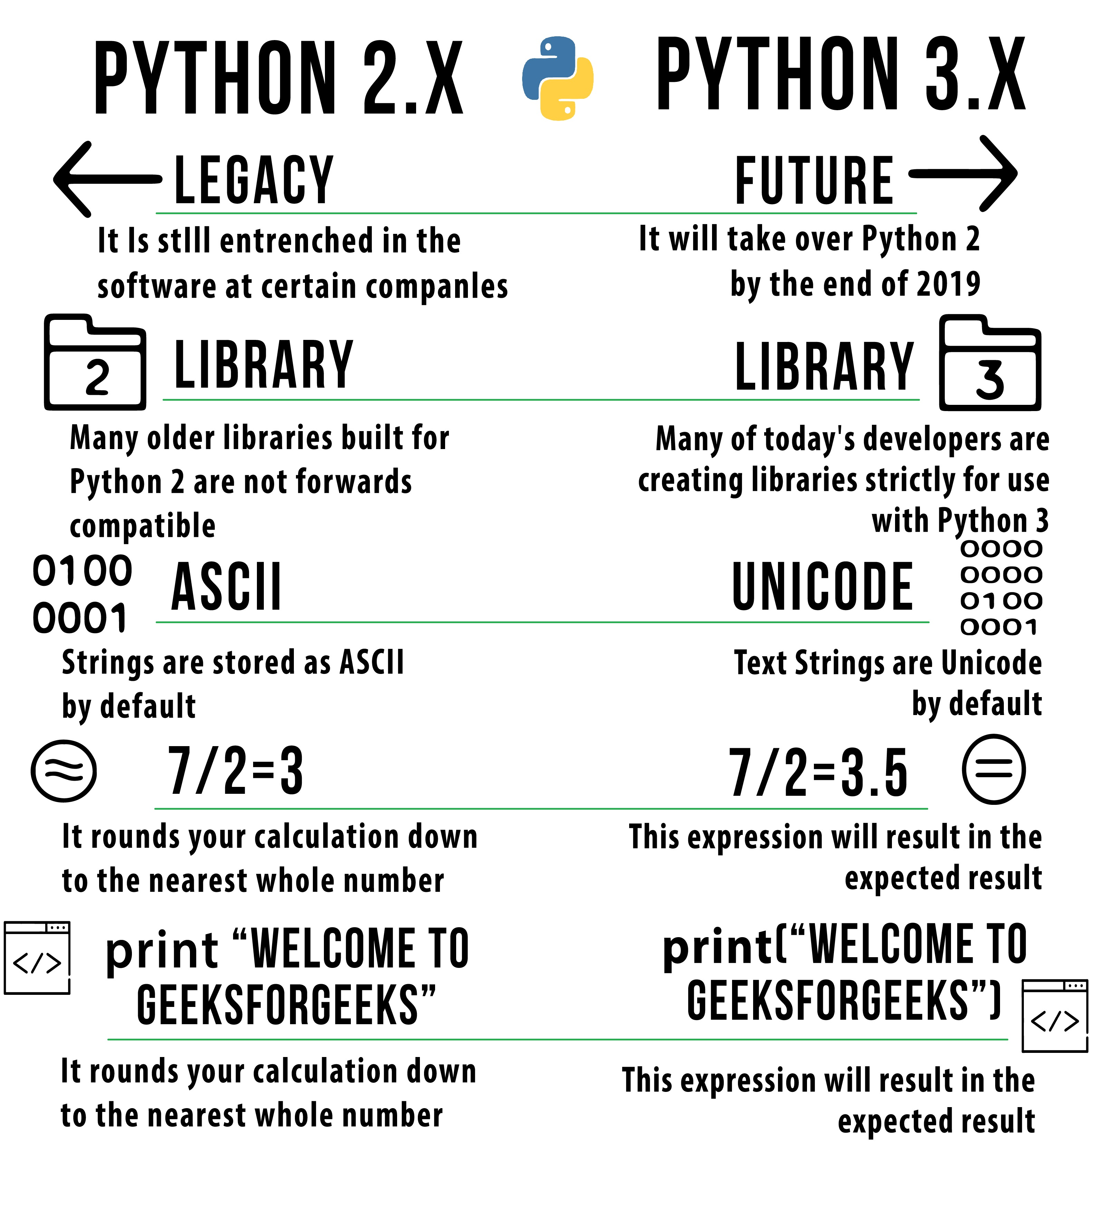
Python 2 vs. Python 3
Python 2 reached its end of life in 2020, and developers are encouraged to migrate to Python 3.
Python 3 introduced improvements like better Unicode support, type hints, and syntax enhancements.
Python 3 is the current version of Python and is actively maintained with new features and updates.
Notes:
Image source: https://stacklima.com/python2-contre-python3-comparaison-de-la-syntaxe-et-des-performances/

Slide 16
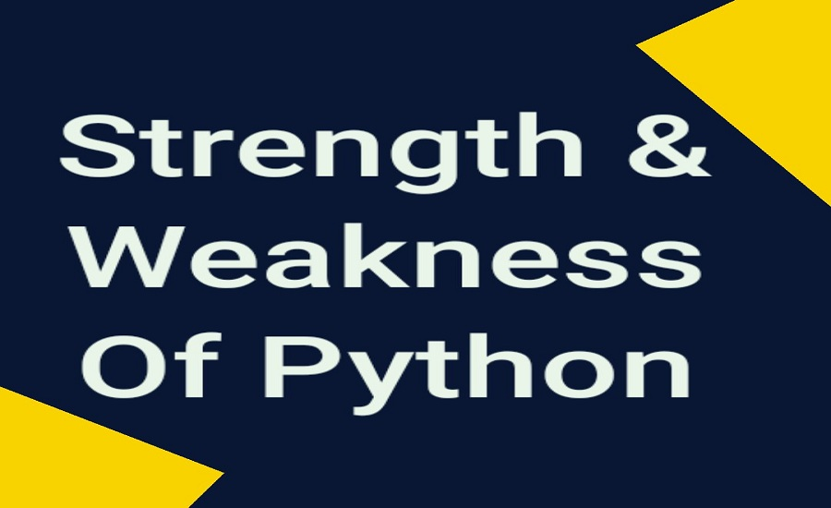
Python's Strengths
Python's readability and simplicity make it easy to learn and use for beginners and experienced developers alike.
Python's extensive standard library and third-party packages provide solutions for a wide range of tasks.
Python's versatility and cross-platform compatibility make it suitable for various applications and domains.
Notes:
Image source: https://easy2learncode.in/strengths-and-weaknesses-of-python/

Slide 17
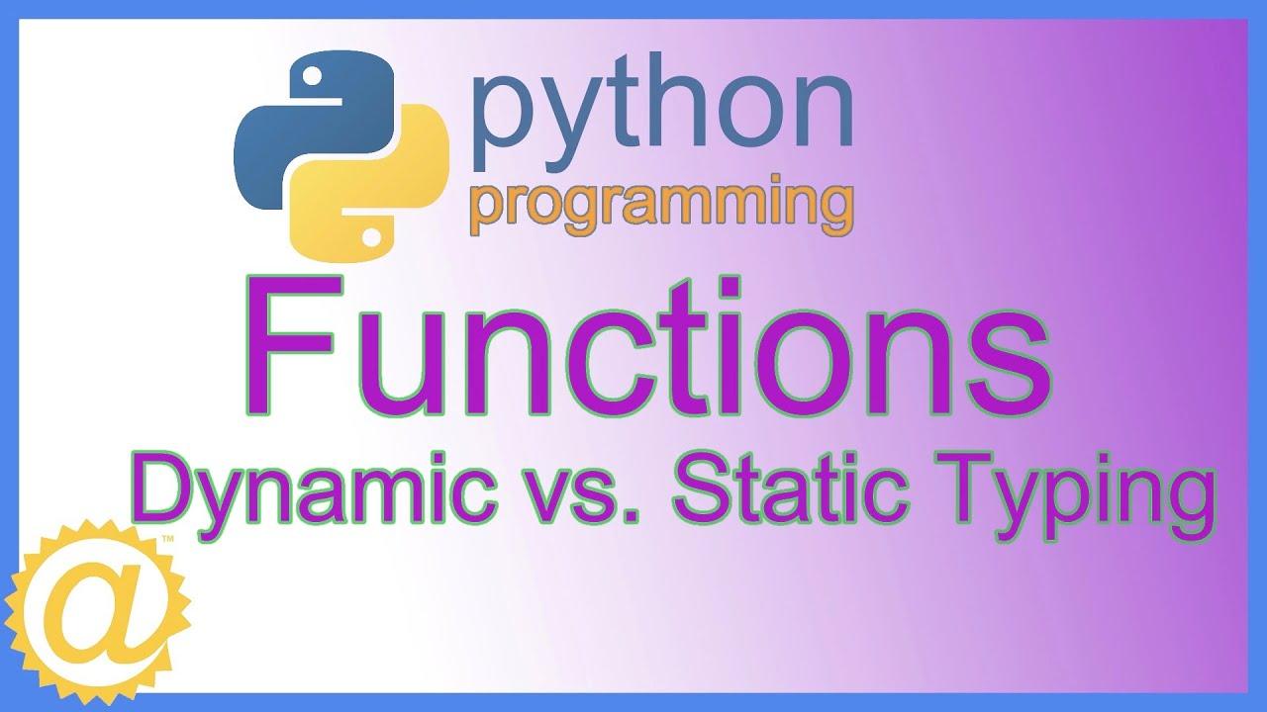
Python's Weaknesses
Python's dynamic typing can lead to potential errors that may not be caught until runtime.
Python's performance may be slower compared to languages like C++ or Java for certain types of tasks.
Python's Global Interpreter Lock (GIL) can limit performance in multi-threaded applications.
Notes:
Image source: https://www.youtube.com/watch?v=FjPUaIAlONA

Slide 18
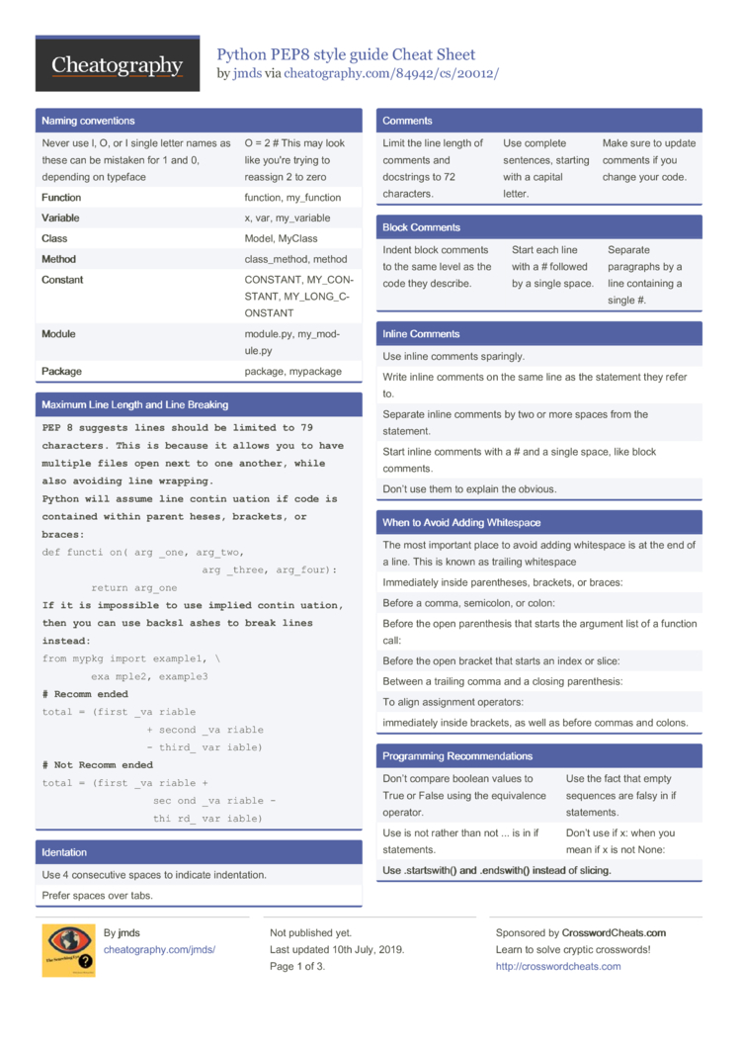
Python Best Practices
Follow the PEP 8 style guide for writing clean and consistent Python code.
Use virtual environments like venv or conda to manage dependencies and project environments.
Write unit tests and documentation to ensure code quality and maintainability in Python projects.
Notes:
Image source: https://htmlcheatsheet.netlify.app/python-pep8-cheat-sheet-pdf.html

Slide 19
Python Career Opportunities
Python developers are in high demand across various industries like technology, finance, healthcare, and more.
Job roles for Python developers include software engineer, data scientist, machine learning engineer, and web developer.
Learning Python can open up opportunities for remote work, freelancing, and entrepreneurship in the tech industry.
Notes:
Image source: https://www.pickl.ai/blog/career-opportunities-in-python/

Slide 20
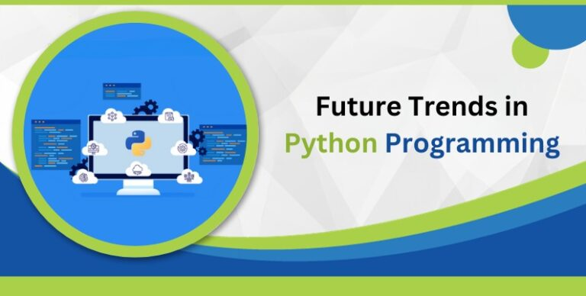
Python Future Trends
Python continues to evolve with new features, improvements, and updates in each release.
Trends like data science, artificial intelligence, and IoT are driving the growth of Python in the tech industry.
Python's community-driven development and open-source nature ensure its relevance and sustainability in the future.
Notes:
Image source: https://qatraininghub.com/future-trends-in-python/

Slide 21
References
Python Official Website: https://www.python.org/
Python Documentation: https://docs.python.org/
Python Software Foundation: https://www.python.org/psf/
(Note: This presentation provides a comprehensive overview of Python, covering its features, applications, strengths, weaknesses, best practices, career opportunities, and future trends.)

